Slide 1


CS 6831 Designing Secure Cryptography
Tom Ristenpart

Slide 2
Block ciphers
Tweakable block ciphers
Tweaking Luby-Rackoff
LRW construction
XE construction
Randomized encryption
OCB core
CTR mode
CBC mode

Slide 3
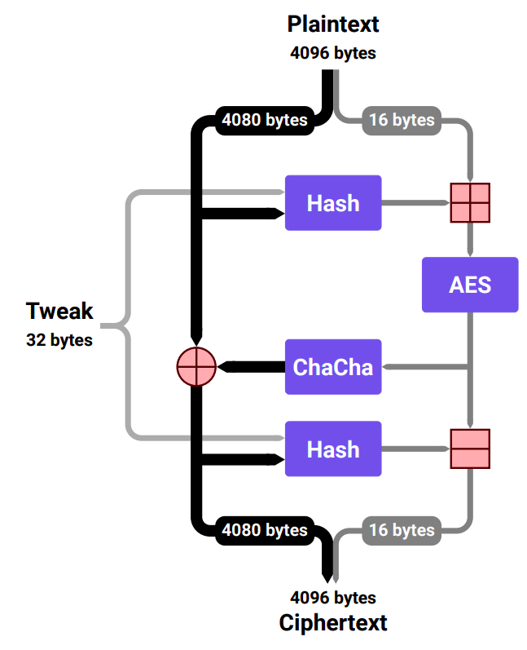
Building a big PRP for disk sector encryption (4096 bytes)
HCTR-mode style construction (unbalanced Feistel)
Using reduced-round ChaCha
Hash based on Poly1305
https://security.googleblog.com/2019/02/introducing-adiantum-encryption-for.html
https://tosc.iacr.org/index.php/ToSC/article/view/7360

Slide 4


Tweakable ciphers
One idea is to “isolate” rows
Ex: distinct key per row
Derive using secret key and row identifier
Breaks search functionality, but prevents per-column frequency analysis
Realizes a tweakable block cipher [Liskov, Rivest, Wagner 2005]
Database
Person | Age | Income
Alice | 22 | 100,000
Bob | 29 | 25,000
Charlie | 31 | 40,000
C1
C2
C3
C1’
C2’
C3’
C1’’
C2’’
C3’’

Slide 5

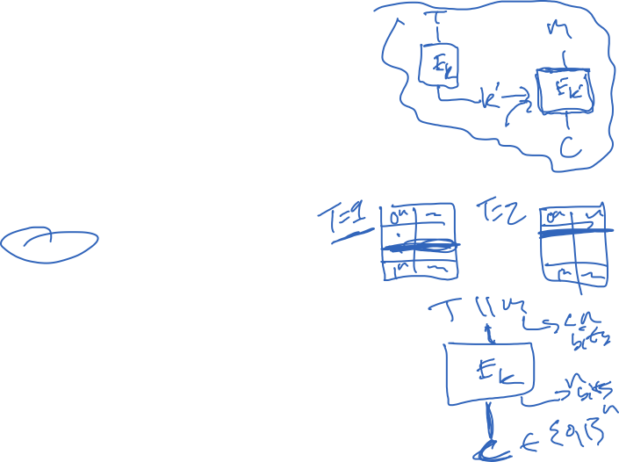
Tweakable ciphers
Set of all functions
such that for fixed tweak, function is a permutation
Extension of PRP/PRF switching lemma applies here to TPRP

Slide 6
Tweakable ciphers
L0 R0
F_{K}
<1> || T
Can tweak Luby-Rackoff pretty easily, if F is PRF with variable input length
(analysis via extension of previous proof)
+
L1 R1
Question: how to do fast TPRP from PRP?
F_{K}
<2> || T
+
L2 R2
F_{K}
<3> || T
+
L3 R3

Slide 7
Tweakable ciphers
Can tweak Luby-Rackoff pretty easily, if F is PRF with variable input length
Question: how to do fast TPRP from PRP?
Assume tweak, message spaces {0,1}^{n}
M
M 1
T
T 1

Slide 8
Tweakable ciphers
Can tweak Luby-Rackoff pretty easily, if F is PRF with variable input length
Question: how to do fast TPRP from PRP?
Assume tweak, message spaces {0,1}^{n}
M
M
M 1
T
T 1
T

Slide 9
Tweakable ciphers
Can tweak Luby-Rackoff pretty easily, if F is PRF with variable input length
Question: how to do fast TPRP from PRP?
Assume tweak, message spaces {0,1}^{n}
M
Why does this work?
Intuition: For all M,T and M’,T’
T
is small

Slide 10



Analysis
M
M
T
Actually this construction
is equivalent to CBC-MAC!
T
CBC-MAC[E](K,M||T)
Special case of [Bellare, Killian, Rogaway 99] gives that for any A there is B s.t.
Here B must make 2q queries when A makes q queries

Slide 11
Analysis
Extension of PRP/PRF
switching to tweaks
CBC-MAC[E] and are
the same
Bellare et al. result on
CBC-MAC. (2q queries)
Should be able to optimize constants with direct reduction to PRP/PRF security of E

Slide 12
Even faster tweakable blockciphers?
Question: how to do fast TPRP from PRP?
Assume tweak, message spaces {0,1}^{n}
M
Requires two E calls per message
Can we do better?
T

Slide 13
Even faster tweakable blockciphers?
Question: how to do fast TPRP from PRP?
Assume message spaces {0,1}^{n}
i
M
Ideal to have something like this, where
i can be an integer
T
But this is insecure!

Slide 14


Essentials on GF(2^{n})
GF(2^{n}) is Finite (Galios) Field over n-bit strings
Represent point a equivalently as:
Polynomial
Integer
Bit string

Slide 15


Essentials on GF(2^{n})
GF(2^{n}) is Finite (Galios) Field over n-bit strings
Addition = bitwise xor of points (as bit strings)
Multiplication:
fix primitive poly. For n = 128 use
Multiple points ac by treating as polynomials, multiplying formal polys, and take remainder mod fixed prim poly
Benefit: element 2 (a = 0¹²⁶10) generates multiplicative subgroup of GF(2^{n})

Slide 16

Essentials on GF(2^{n})
Multiplication by 2 is fast!
Divide by primitive polynomial and take remainder
If a_{n-1} = 1 then:
left-shift a by 1 and add prim poly
If a_{n-1} = 0 then:
left-shift a by 1
One shift and one conditional xor!

Slide 17
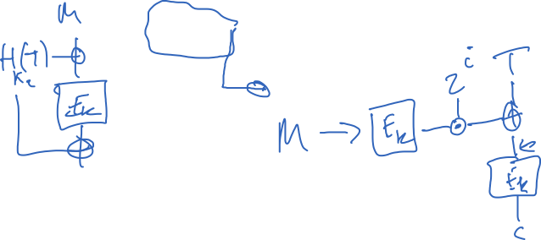
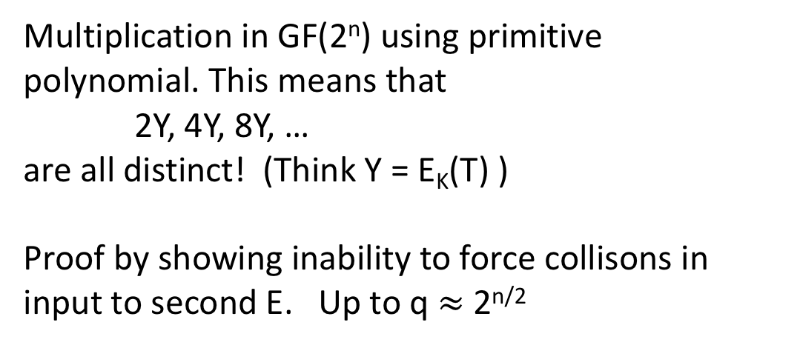
Fast TPRPs: XE construction
[Rogaway 2004]
Given a good PRP (e.g., AES) how do we build a tweakable PRP?
Assume
M
Multiplication in GF(2^{n}) using primitive
polynomial. This means that
2Y, 4Y, 8Y, …
are all distinct! (Think Y = E_{K}(T) )
Proof by showing inability to force collisons in input to second E. Up to q $≈$ 2^{n/2}
2^{i}
T
But is this faster than previous constructions??
Yes in an amortized sense:
Computing 2Y given Y is 1 shift and 1 conditional xor!

Slide 18


Towards randomized symmetric encryption
M1
M2
M3
C1
C2
C3
Encrypted with ECB
Images courtesy
of Wikipedia

Slide 19
CPA-core of OCB mode
Tweakable block ciphers can fix all this!
Let N be an n-bit nonce (only use once)
and use XE mode (or other suitable tweakable BC):
M1
M2
M3
C1
C2
C3
Remember our tweakable block cipher mode XE:

Slide 20

CPA-core of OCB mode
Tweakable block ciphers can fix all this!
Let N be an n-bit nonce (only use once)
and use XE mode (or other suitable tweakable BC):
M1
M2
M3
C1
C2
C3
Encrypted with OCB
Images courtesy
of Wikipedia

Slide 21
Randomized encryption
Symmetric encryption scheme is tuple
(randomized) key generation
(randomized) encryption
(deterministic) decryption
Assume length of ciphertext determined solely by length of message: clen(|M|)

Slide 22

Real-or-random indistinguishability
Can’t distinguish from random bits under chosen-message attack
Adversary can repeatedly query Enc on same message

Slide 23



Slide 24
Counter-mode for block cipher
IV + 1
IV + 2
IV + 3
IV is random 128 bit value
E_{K}
E_{K}
E_{K}
P1
P2
P3
M1
M2
M3
C1
C2
C3

Slide 25
CBC mode for block cipher
IV is random 128 bit value
M₁
M₂
M₃
IV
E_{K}
E_{K}
E_{K}
C₀
C₁
C₂
C₃

Slide 26
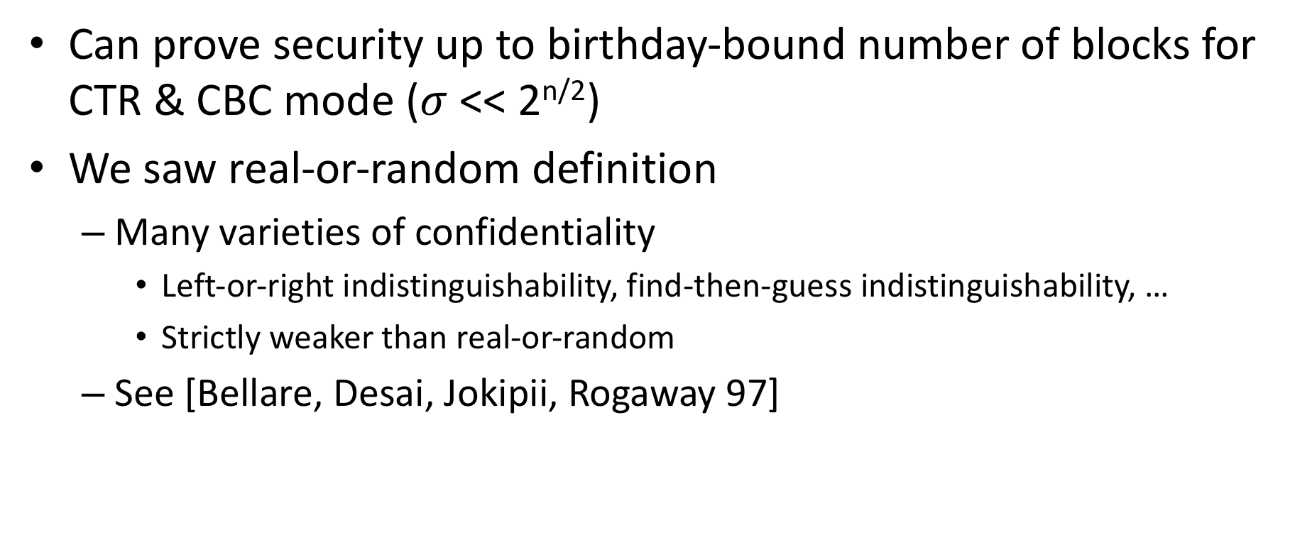
Randomized modes
Can prove security up to birthday-bound number of blocks for CTR & CBC mode ($σ$ << 2^{n/2})
We saw real-or-random definition
Many varieties of confidentiality
Left-or-right indistinguishability, find-then-guess indistinguishability, …
Strictly weaker than real-or-random
See [Bellare, Desai, Jokipii, Rogaway 97]

